Slide 1
Was the Paycheck Protection Program Fair?
By Salvador Mendiola
Computer Science Major
Philander Smith College Student

Slide 2
The PPP Defined:
The Paycheck Protection Program is a federal program that consisted of loaning to small businesses affected by the COVID-19 pandemic.
The loans can be up to $10 million and is only for businesses with 500 employees or less.
About $800 billion in loans was provided by the U.S. Government.

Slide 3
Cause
Paycheck Recipients
01
02
Data Analysis
Conclusions
03
04
The PPP Continued:
47% of US workers were affected by the lockdown of small businesses creating potential job loss
The people to be supported were workers, creditors, suppliers, owners, and shareholders
According to a scholarly journal, most of the funds went to the highest quintile of households, which is mostly made of owners and shareholders
The lack of targeted federal support resulted in this disparity. Purpose was to get the funds out as soon as possible (speed vs precision)
Data taken from “The $800 Billion Paycheck Protection Program: Where Did the Money Go and Why Did It Go There?”

Slide 4

$510 billion in loans were provided in 2020
Where did the money go?

Slide 5
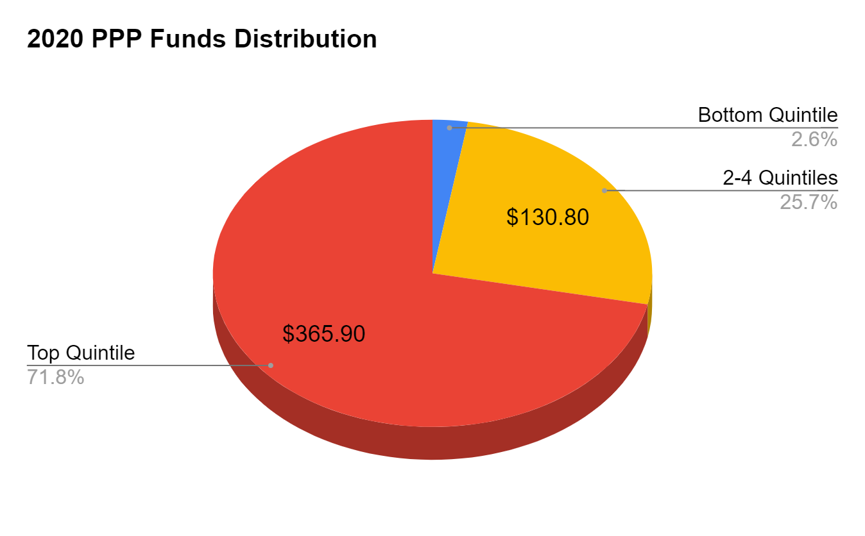
Scholarly Article Results analysis:
72%
of the $510 billion went to the highest quintile of households

Slide 6
The Research
Motivation
Research Questions
Hypothesis
To research the fairness of the PPP on a specific group
Did the disparity affect some areas more than others? Is there a clear disparity? How were rural or urban businesses affected?
Having a small business in an urban area in the U.S. increases the amount of money loaned and loans forgiven as the number of employees increases

Slide 7

Methodology
Programming Language
Visualization
Data Analysis
Other methods used:
Used Python and google colab due to past experience and cloud usefulness. Made two notebooks: one to focus on amounts higher than $150K, and one for less than $150k.
Used scatterplot to look for correlation
Data was taken from a public dataset provided by the small business administration.
Used RandomForestRegression to calculate R2 and Explained Variance Score.
LinearRegression
KNeighborsRegressor
Ridge Explained Variance
Bayesian Ridge Explained Variance
ElasticNet Explained Variance

Slide 8
01
Businesses loaned over 150k
Rural Entries: 136192
Urban Entries: 738629
Data taken from

Slide 9
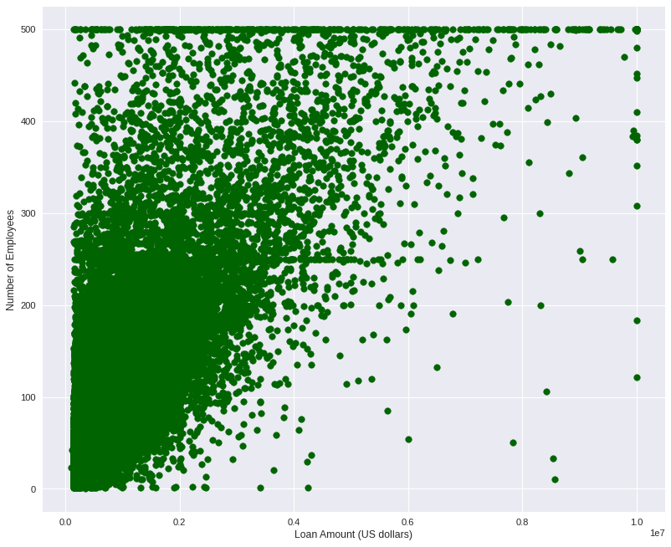
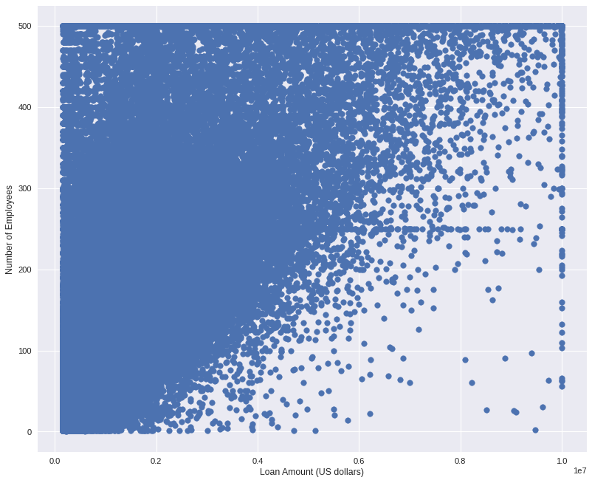
Total Proceeds (Loans)
Rural Businesses
Urban Businesses
R2 score | 0.8544358249777163
E.V. Score | 0.8544358295496426
R2 score | 0.7827286147409481
E.V. Score | 0.7827286151769458

Slide 10
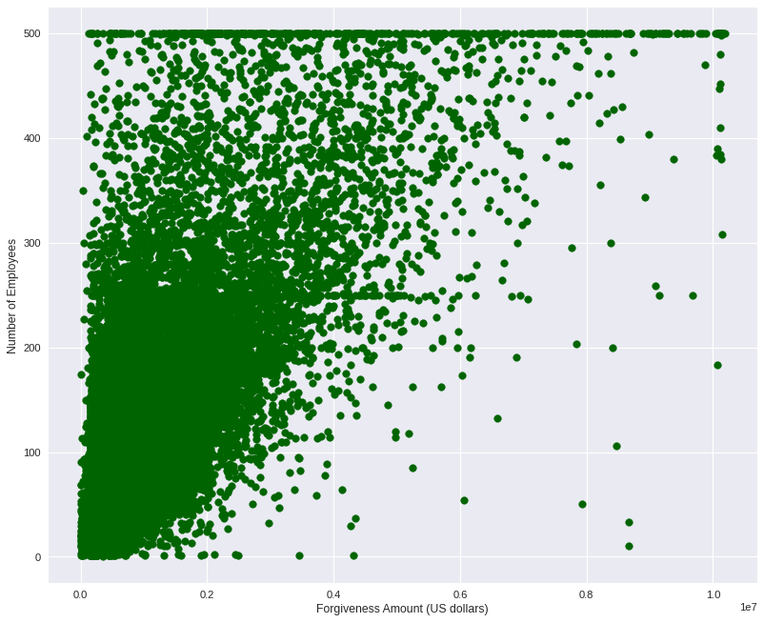
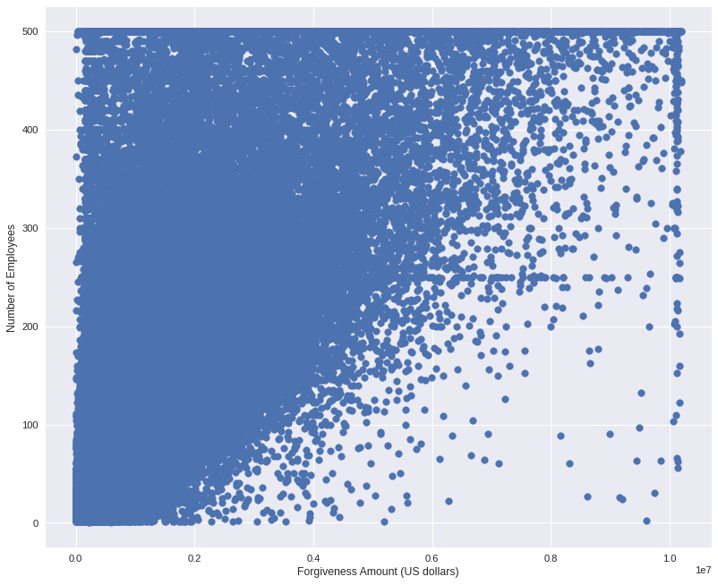
Loan Forgiveness
Rural Businesses
Urban Businesses
R2 score | 0.9126921236043838
E.V. Score | 0.9126924239413081
R2 score | 0.8856711341622401
E.V. Score | 0.885671313078474

Slide 11
02
Businesses loaned less than 150k
Rural Entries: 365688
Urban Entries: 978972

Slide 12
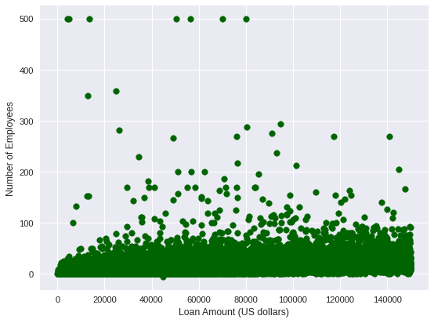
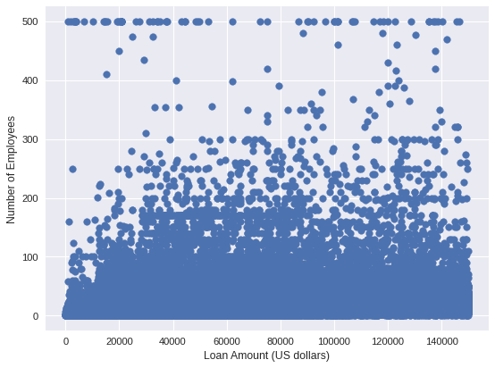
Total Proceeds (Loans)
Rural Businesses
Urban Businesses
R2 score | 0.6196295093124321
E.V. Score | 0.6196295222453968
R2 score | 0.3944666089185721
E.V. Score | 0.3944672839037141

Slide 13
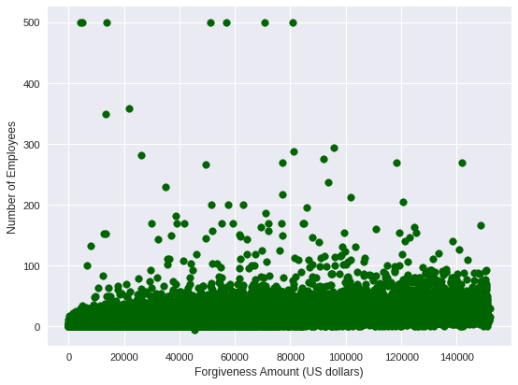
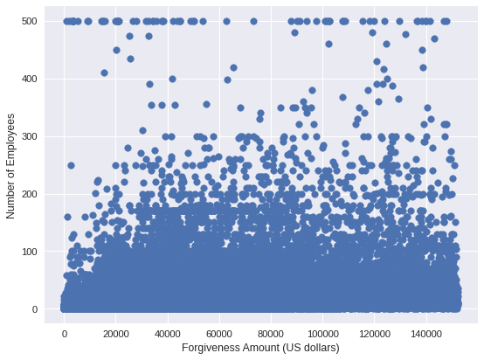
Loan Forgiveness
Rural Businesses
Urban Businesses
R2 score | 0.837061238454861
E.V. Score | 0.837061238454861
R2 score | 0.7545942628138574
E.V. Score | 0.7545943339304089

Slide 14
Hypothesis Somewhat Proven
No evidence of disparity between rural and urban businesses in terms of funding
Number of employees correlates to loan amount and loan forgiveness amount
The amount of money loaned and money forgiven does increase as the number of employees increase.
However, this is only true for businesses that were loaned and forgiven for more than 150k
Data shows that urban fund trends are for the most part equal to rural fund trends
Further research should explore disparity in other areas such as ethnicity, gender, and/or type of business (agriculture, technology, etc) to find correlation for businesses loaned below 150k

Slide 15
References
Autor, D., Cho, D., Crane, L. D., Goldar, M., Lutz, B., Montes, J., Peterman, W. B., Ratner, D., Villar, D., & Yildirmaz, A. (2022). The $800 Billion Paycheck Protection Program: Where Did the Money Go and Why Did It Go There? Journal of Economic Perspectives, 36(2), 55–80. https://doi.org/10.1257/jep.36.2.55
https://www.sba.gov/funding-programs/loans/covid-19-relief-options/paycheck-protection-program
DATASET: https://data.sba.gov/dataset/ppp-foia

